Slide 1

Module 3.4
Montana Teen Driver Education and Training
Sharing the Road
Share the road. Drive with courtesy.

Slide 2

Careless driving. A person operating or driving a vehicle on a public highway shall drive it in a careful and prudent manner that does not unduly or unreasonably endanger the life, limb, property, or other rights of a person entitled to the use of the highway.
MCA 61-8-302

Slide 3
Highway Transportation System (HTS)
People: Transportation users
Vehicles: Transportation modes
Roads: Transportation routes

Slide 4
Underlying Question
What do the people on the following slide
have in common?

Slide 5








Photos courtesy of http://www.stockvault.net/

Slide 6
They have all made a choice about how they use the HTS.

Slide 7
Characteristics of HTS Users
They are all ages
They are multinational
Different races and genders
They have different skill levels
They have different experiences
They use different modes of transportation
The majority assume they have great driving skills

Slide 8
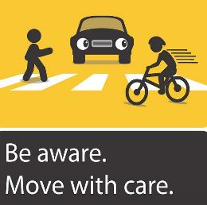
Characteristics of HTS Users
Most importantly, they all expect to use the HTS SAFELY!

Slide 9
Video Activity 1
Watch the video on the next slide depicting a small town main street. See how many different types of HTS users you can identify.

Slide 10
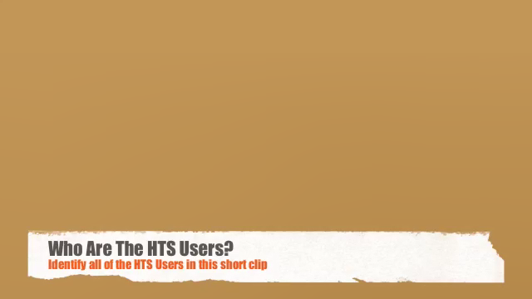
Video Activity 1:
Identify Users of the HTS
PLAY VIDEO (1:23)

Slide 11
Did you get them all?
Pedestrians
Motorcyclists
Drivers of:
  SUVs
  Pickups
  Passenger Cars
  Minivans
  Small Box Trucks

Slide 12
Who else is out there?
Horseback riders
Bicyclists
People in wheelchairs
Skateboarders
ATVers
Snowmobilers
Drivers of:
  RVs with and without trailers
  Farm equipment
  Buses (school and luxury)
  Semi-trucks

Slide 13
Choices
Every user has made a choice on how they will use the HTS.
Think …
What if their choice is different from yours?
Will you respect their choice and accept that they may use the HTS differently than you?

Slide 14
Vehicles
Modes of Transportation
Notes:
Road Alligators

Slide 15
Modes of Transportation
Many different types of vehicles
All levels of maintenance
Wide range of models and ages of a vehicles
Different handling characteristics
Ability to operate in different environmental situations
Notes:
Road Alligators

Slide 16
Every HTS User is a Zone Change!
See the Zone Change.
Employ the vehicle control sequence.
How do you do that?
Solve the Zone Change by increasing space and time.

Slide 17
Student Activity 2: Sharing the Road
Have your Sharing the Road worksheet in front of you. Look at the 12 photos that follow showing different modes of transportation.
Working in groups of 2-3:
Identify the Characteristics of each mode.
Strategize on how you can Share the Road with these users.
Notes:
Road Alligators

Slide 18
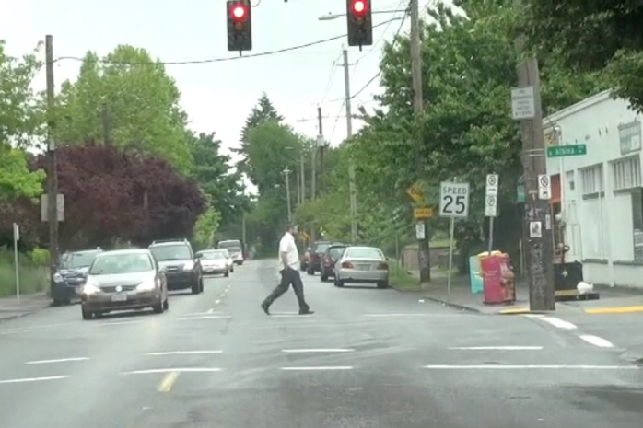

Slide 19
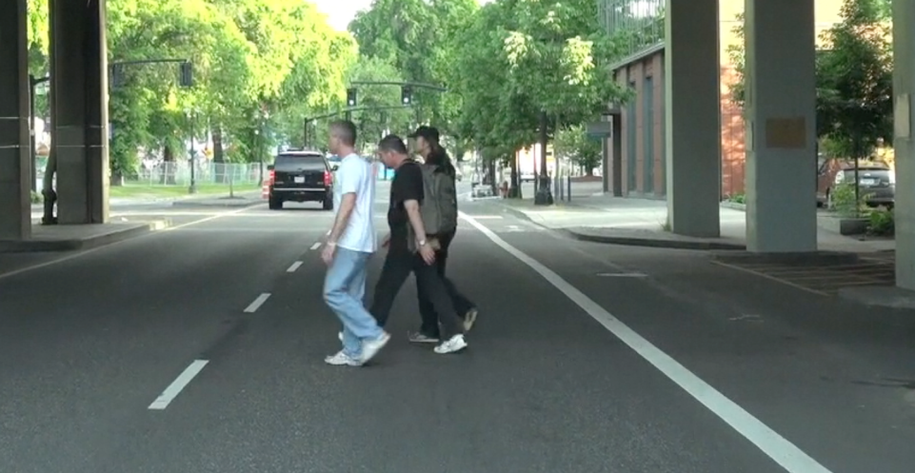

Slide 20
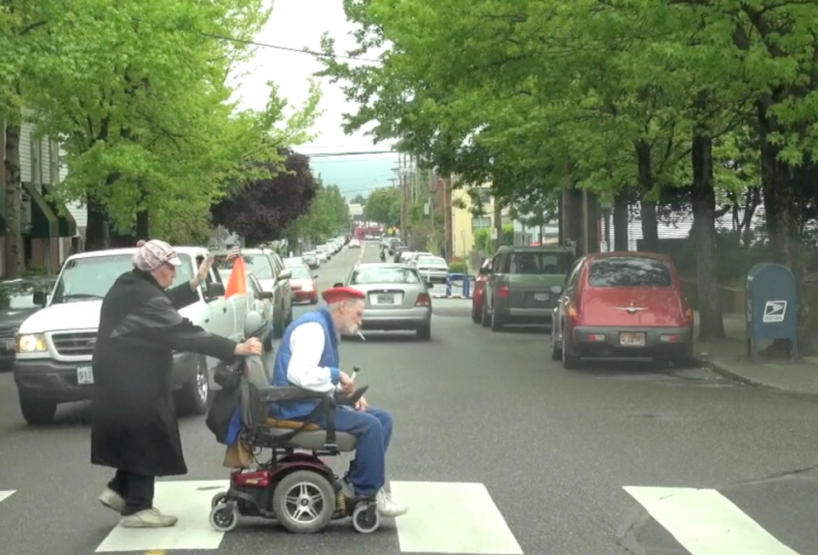

Slide 21
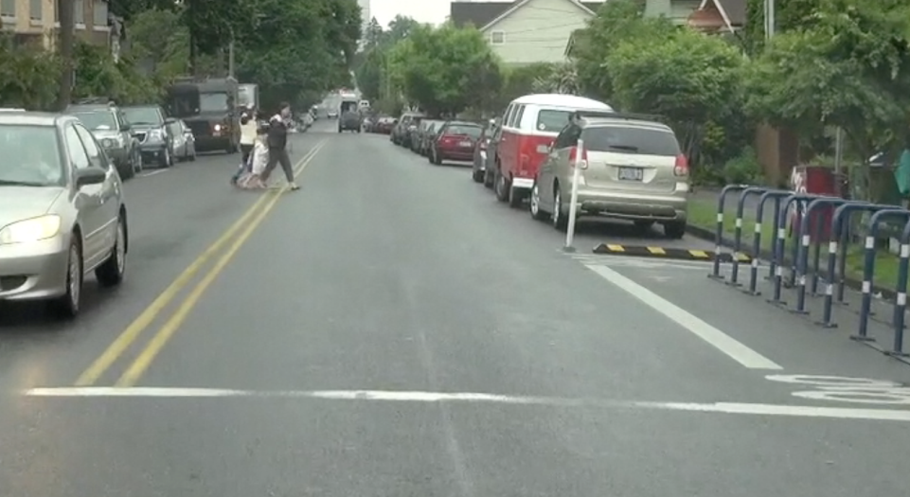

Slide 22
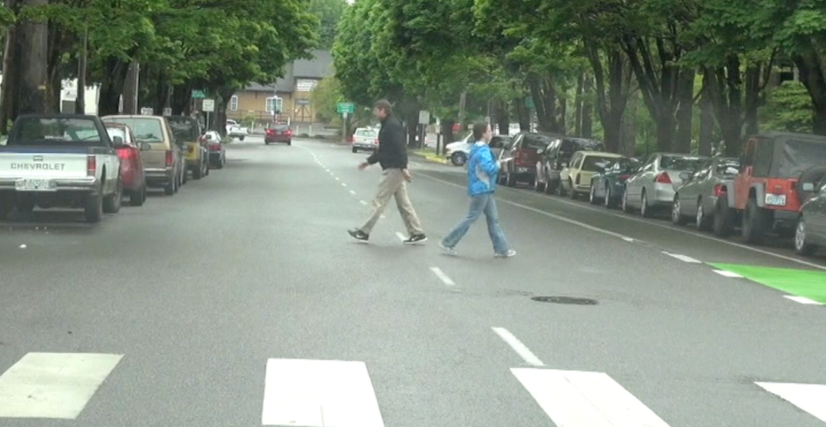

Slide 23
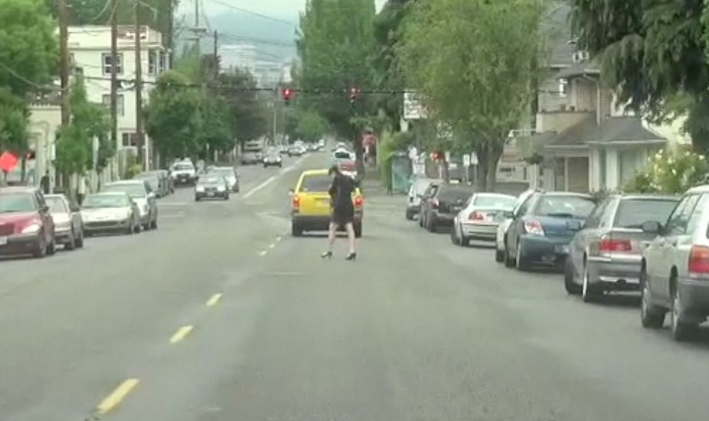

Slide 24
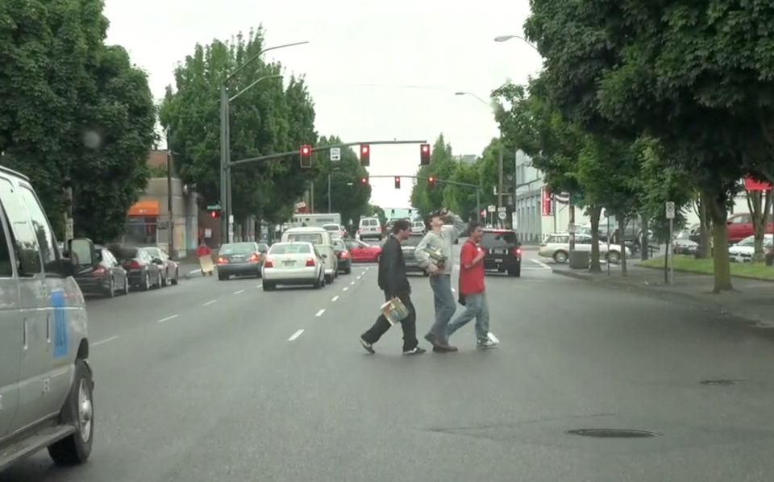

Slide 25
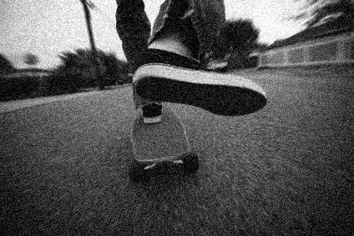

Slide 26
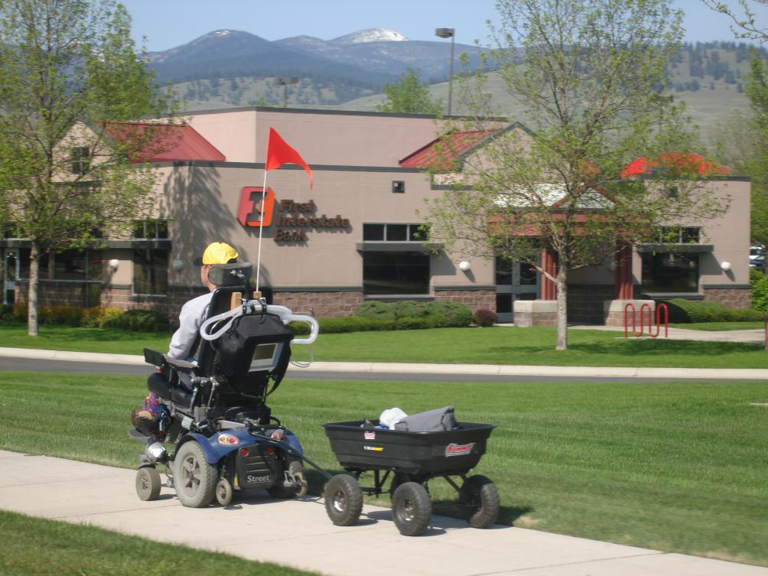

Slide 27
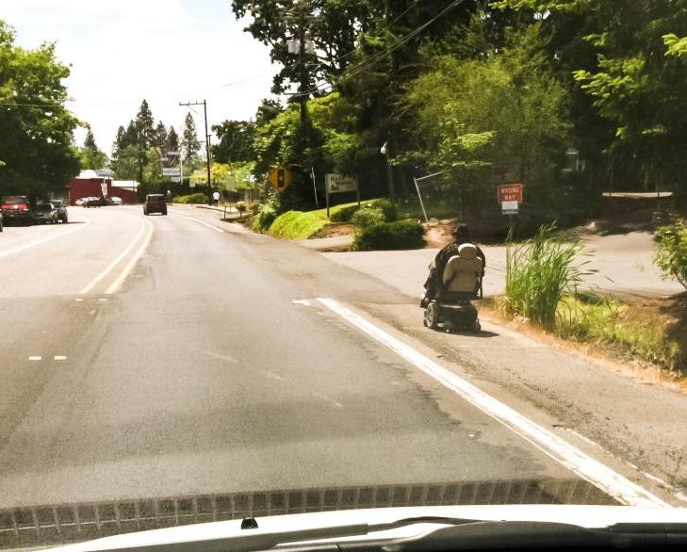

Slide 28
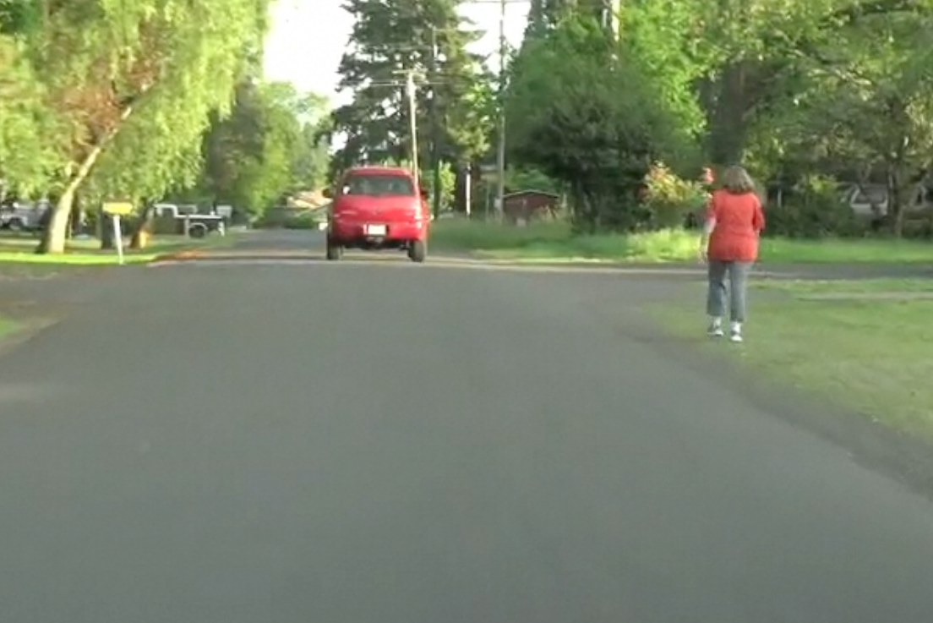

Slide 29
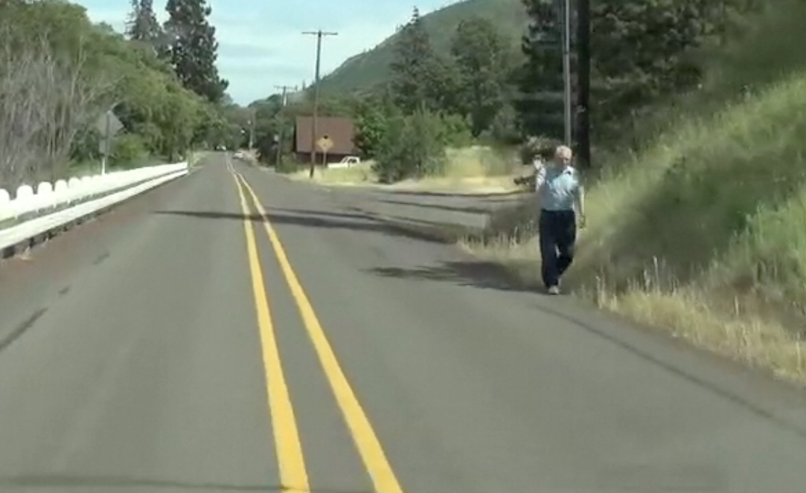

Slide 30
PEDESTRIANS
CHARACTERISTICS
SHARING THE ROAD STRATEGIES
Suggested Characteristics:
Size and Visibility:
Speed:
Protection:
Predictability:
Where Found:
Operating space:
Suggested Strategies:
Scanning Strategies?
Speed Control?
Lane Position?
Communication?
Assumptions?
Use this template to identify the characteristics and strategies of the other HTS users.

Slide 31
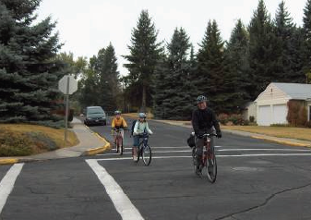
BICYCLISTS
See also the Bicycle Awareness presentation with a video on sharing the road with bicycles and an interactive quiz on the rules of the road for bicyclists and motorists.

Slide 32
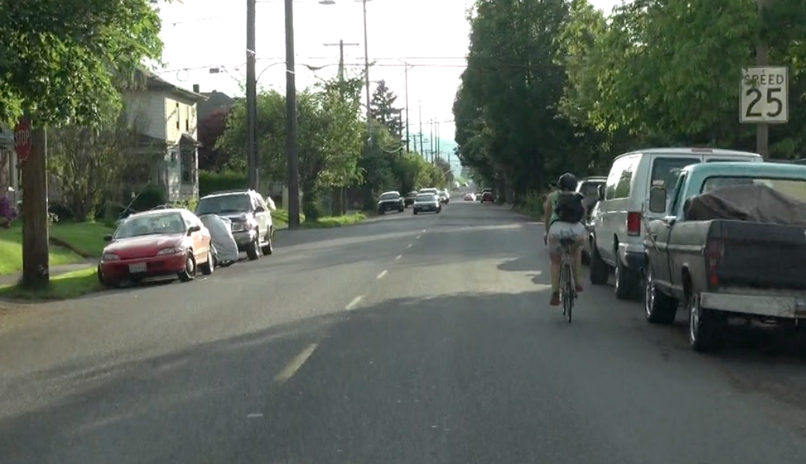
How is your right front zone?
How is your left front zone?
What other zones should you check?
What should you do to share the road with this cyclist?

Slide 33
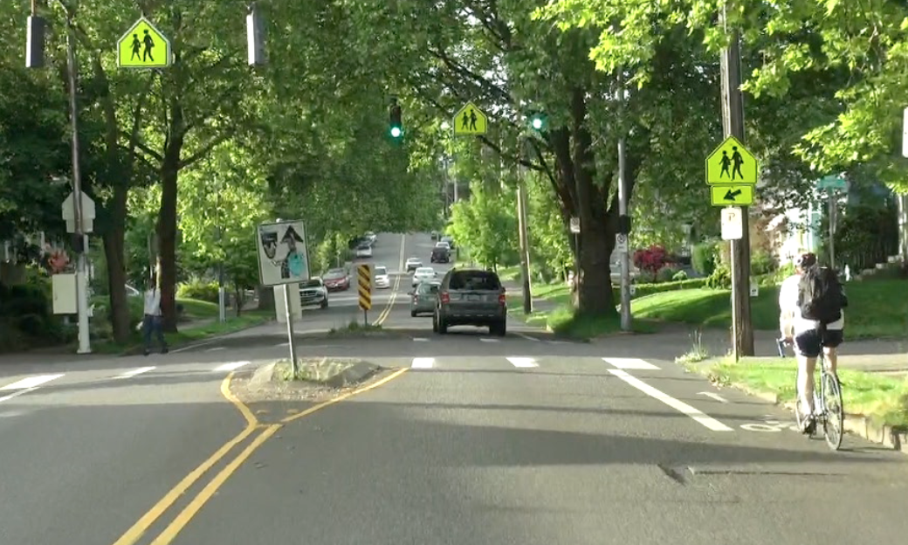
How is your right front zone?
How is your left front zone?
What other zones should you check?
What should you do to share the road with this cyclist?

Slide 34
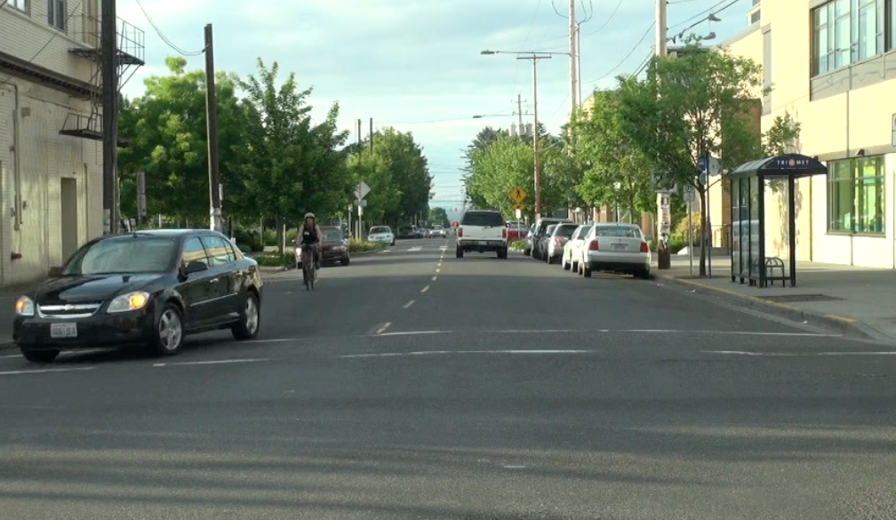
You are about to make a left turn
How is your left front zone?
What should you do?

Slide 35
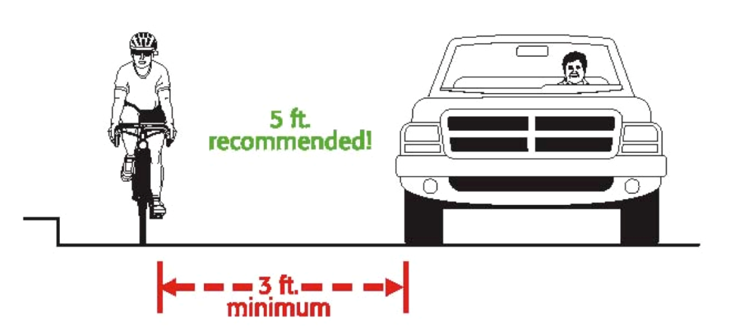
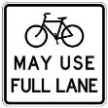
Sharing the Road with Bicyclists
Passing Safely
Drivers can cross the yellow centerline to pass a person on a bicycle. Slow down and wait until it is safe to pass.
MCA 61-8-326
Notes:
MCA 61-8-326 No Passing zones amended to permit crossing center line to pass when “there is sufficient clear sight distance to the left side of the center of the roadway”
MCA 61-8-605 Riding on Roadways (1)A person operating a bicycle on a roadway at less than the normal speed of traffic shall ride in the right-hand lane of the roadway, subject to the following provisions:
If the right-hand lane is wide enough to be safely shared with the overtaking vehicles , a bicyclist shall ride far enough to the right as judged safe by the bicyclist to facilitate the movement of overtaking vehicles unless other conditions make it unsafe to do so.
A bicyclist may use a lane other than the right-hand lane when:
i) overtaking and passing a slower vehicle
ii) Preparing for a left turn at an intersection or into a private road or driveway:
iii) The right-hand lane is a dedicated right turn lane and the bicyclist does not intend to turn right; or
iv) It is necessary to avoid a condition that makes it unsafe to right in the right-hand lane of the roadway
2) A person operating a bicycle on a one-way roadway with two or more marked traffic lanes may ride as close to the left side of the roadway as judged safe by the bicyclist
3) Persons riding bicycles on a roadway shall ride in single file except when:
a) riding on paths or parts of roadway set aside for the exclusive use of bicycles;
b)Overtaking and passing another bicycle
c) Riding on a paved shoulder or in a parking lane, in which case the persons may ride two abreast; or
d) Riding within a single lane on a laned roadway with at least two lanes in each directions, in which case the persons may ride two abreast only if they do not impede the normal and reasonable movement of traffic more that they would otherwise impede traffic by riding single files and accordance with the provisions of the chapter.
4) A bicyclist is not expected or required to ride:
Over or through hazards at the edge of a roadway, including but not limited to fixed or moving objects, parked or moving vehicles, bicycles, pedestrians, animals, surface hazards, or narrow lanes; or
without a reasonable margin of safety on the right side of the roadway

Slide 36
Bicyclists
CHARACTERISTICS
SHARING THE ROAD STRATEGIES

Slide 37
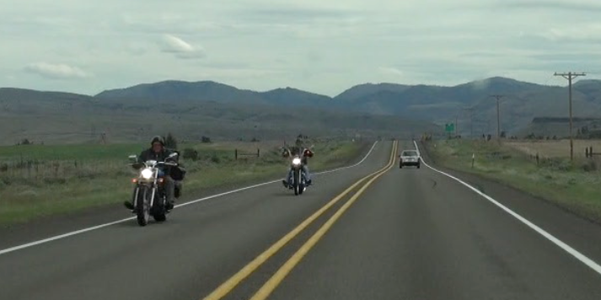
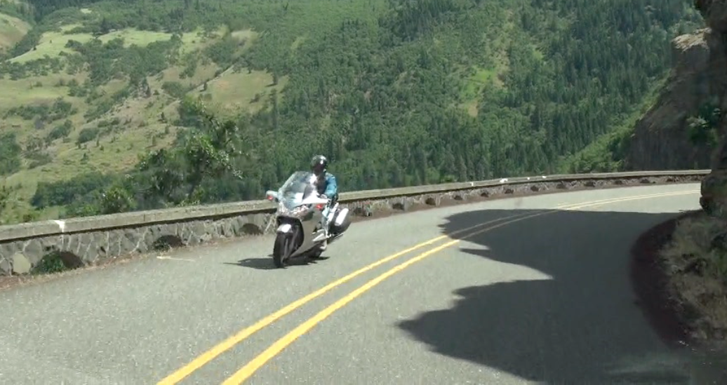
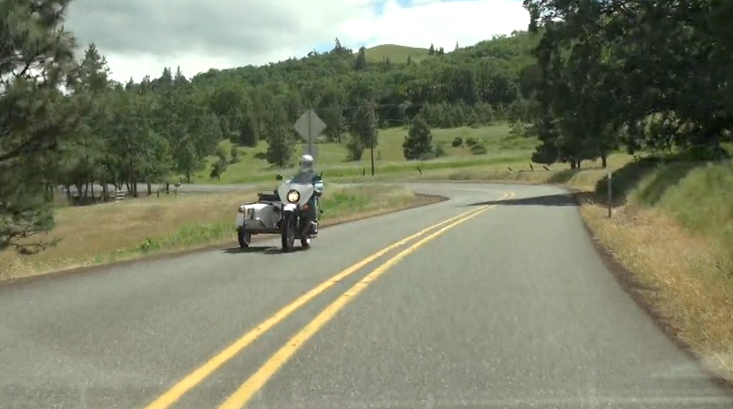
MOTORCYCLISTS

Slide 38
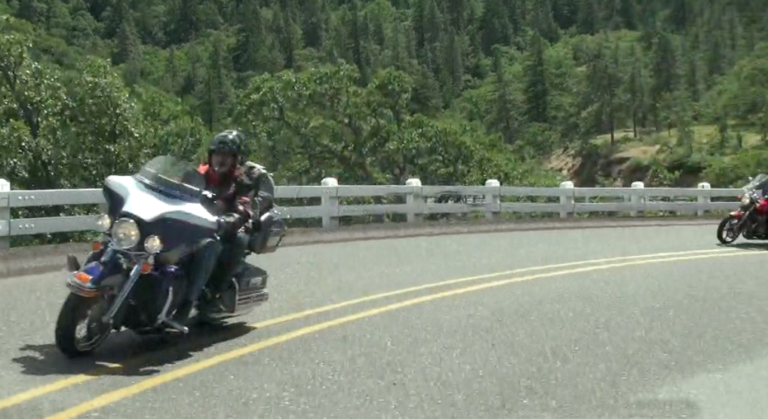
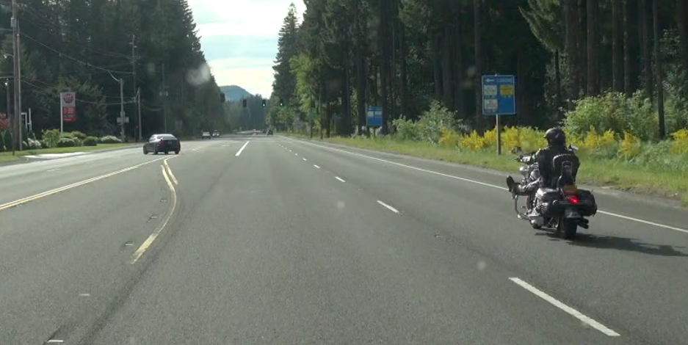
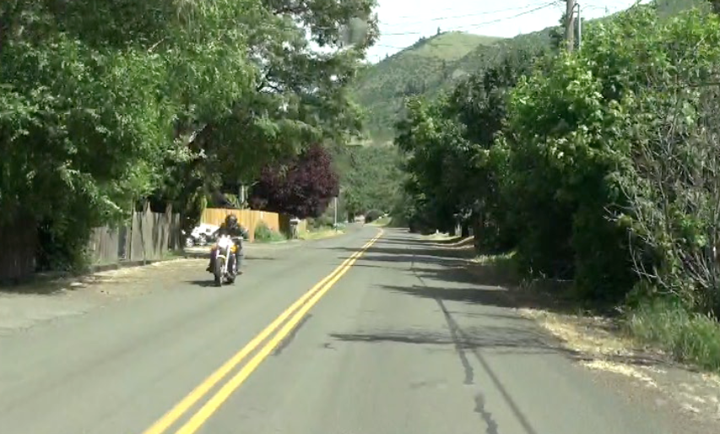
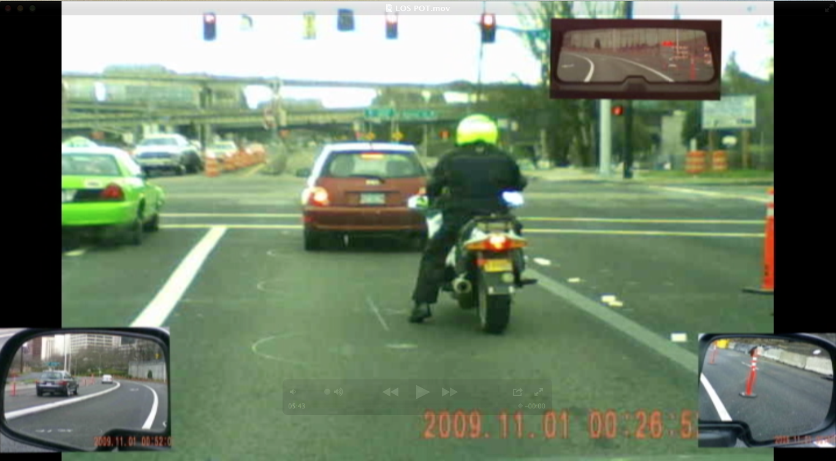

Slide 39
Motorcyclists
CHARACTERISTICS
SHARING THE ROAD STRATEGIES

Slide 40
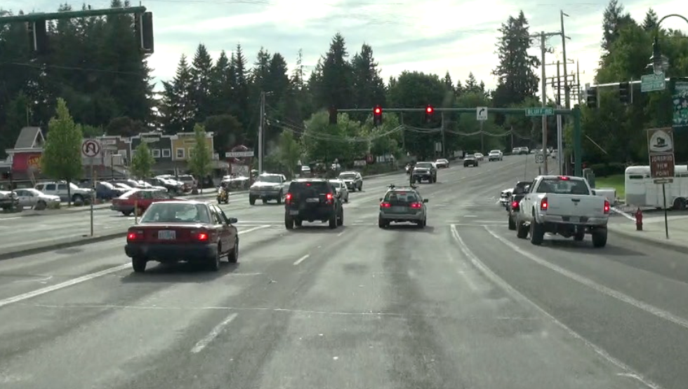
PASSENGER CARS AND PICKUPS

Slide 41
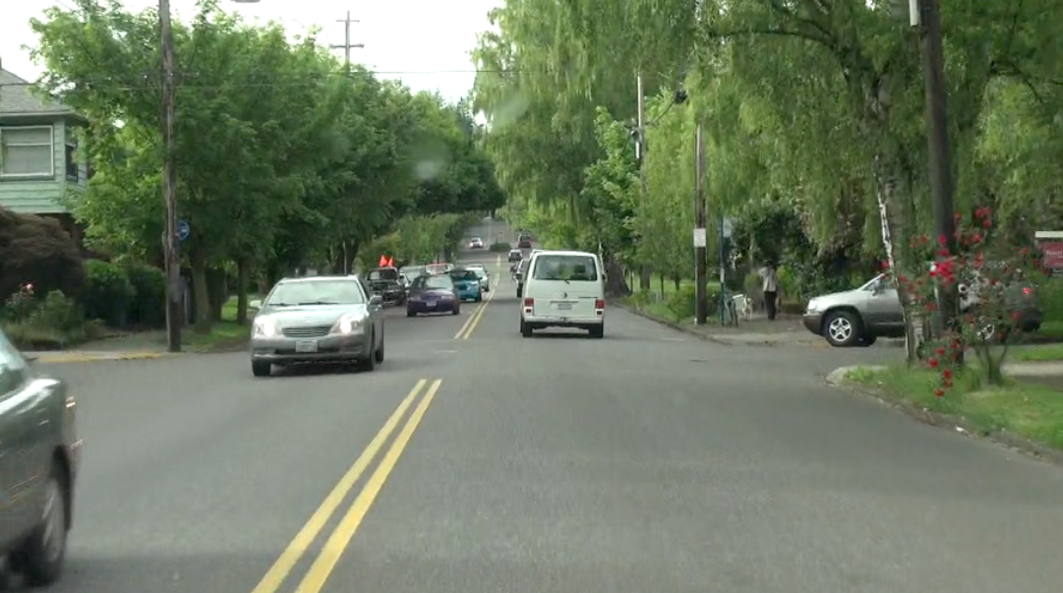
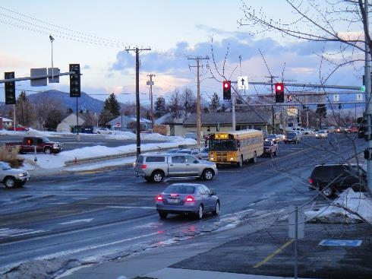

Slide 42
Passenger Cars and Pickups
CHARACTERISTICS
SHARING THE ROAD STRATEGIES

Slide 43
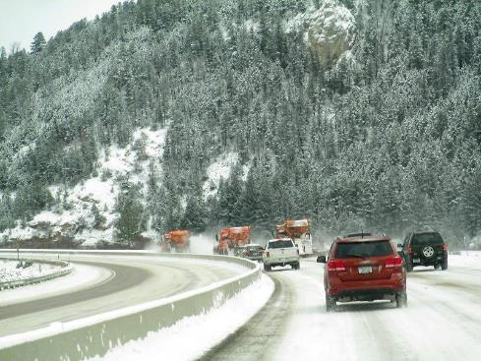
CONSTRUCTION WORK ZONE VEHICLES AND SNOW PLOWS

Slide 44
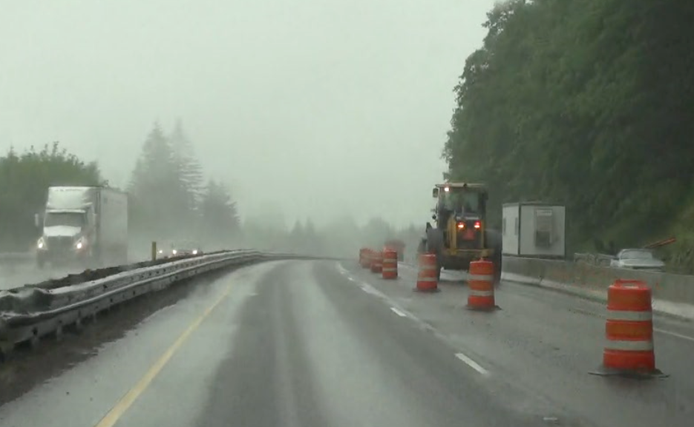
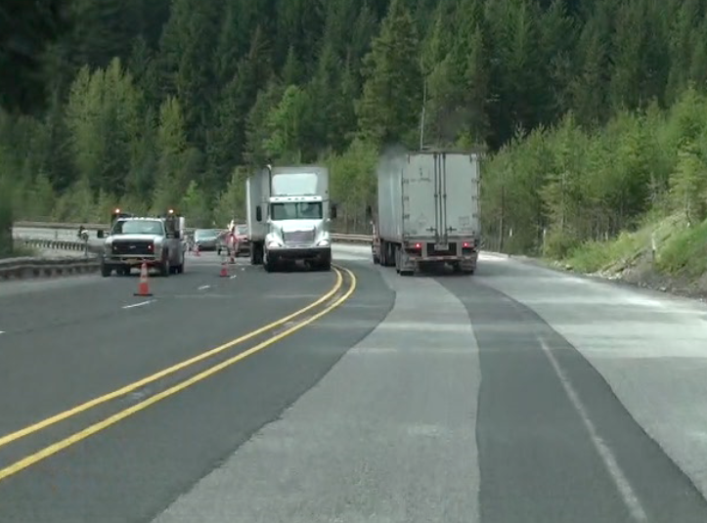

Slide 45
Construction Work Zone Vehicles and Snow Plows
CHARACTERISTICS
SHARING THE ROAD STRATEGIES

Slide 46
EMERGENCY VEHICLES
What is Montana’s Move Over Law?
What types of emergency vehicles does this law apply to?
What actions do you need to take when you approach a stopped emergency vehicle on the road side?
What should you do if one approaches you from behind with its lights on?

Slide 47
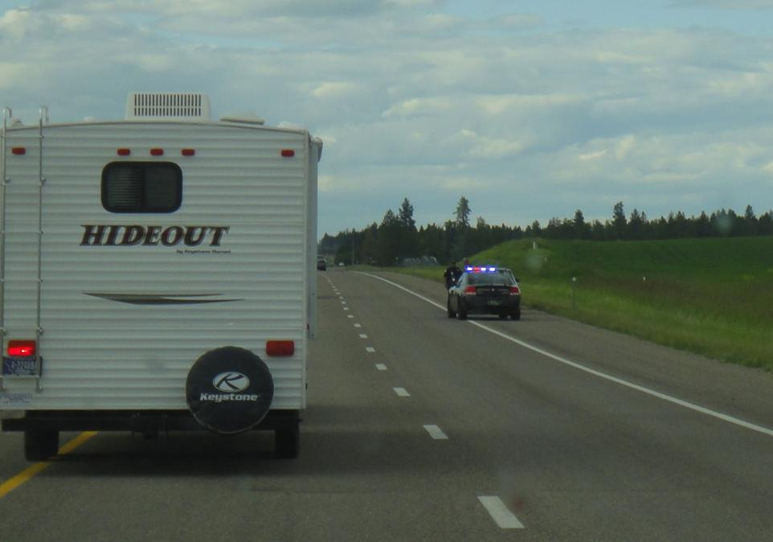
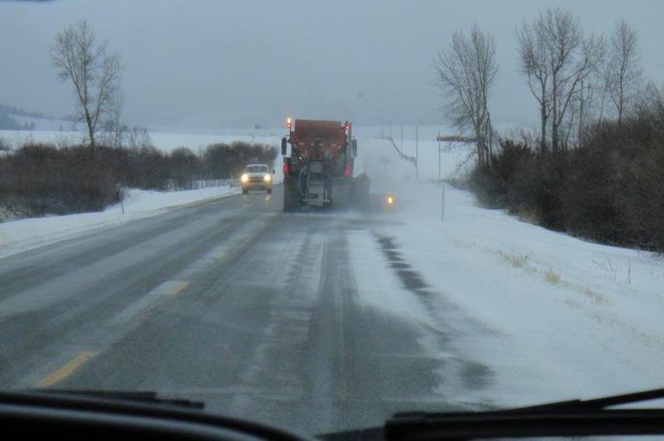
What do you need to do to safely share the road with these two vehicles?
Notes:
Move over and yield to emergency vehicles using a siren and red or blue flashing lights.
Don't crowd the plow! Snow plow drivers have many blindspots and just because you can see them, doesn't mean that they can see you.
Plows aren't just removing snow. They may also be spreading sand or deicer on the road.
1. maintain a safe following distance (at least four car lengths behind the plow)
2. Never pass a plow on the right
3. Be patient- do not pass a plow during low visibility. The plow will pull over when it’s safe to let other vehicles safely pass.
4. Slow down!
Plows are large and move slower than highway speeds. It is difficult to judge distance when approaching the plow so slow down immediately to avoid a collision

Slide 48
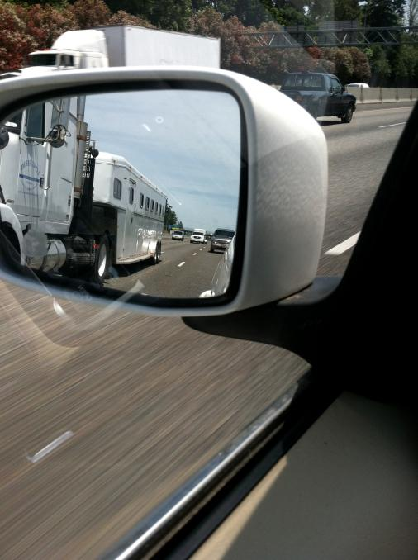
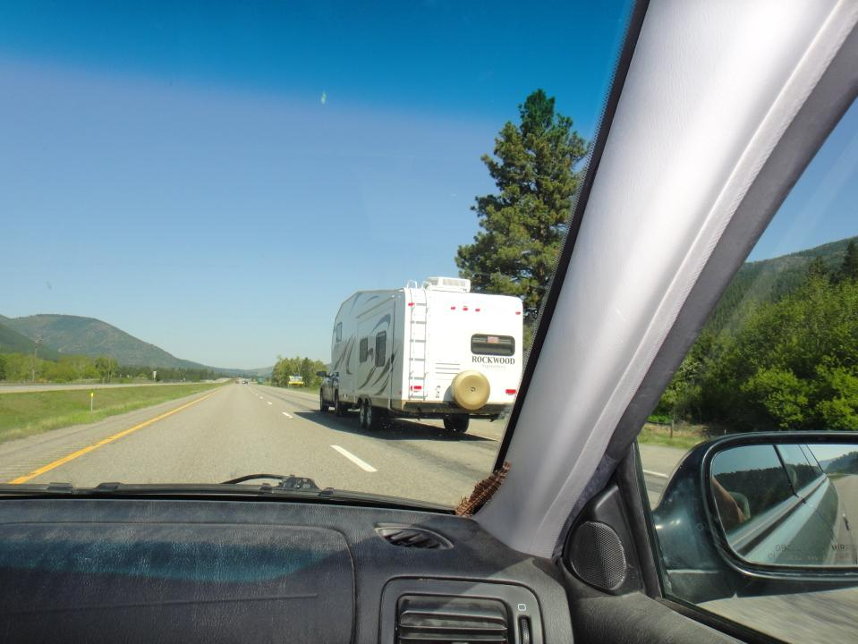
RECREATIONAL VEHICLES
AND TRAILERS

Slide 49
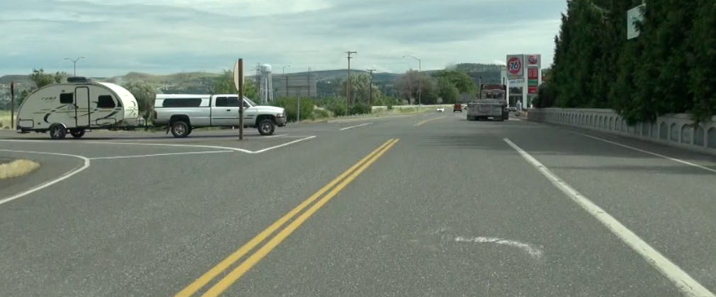
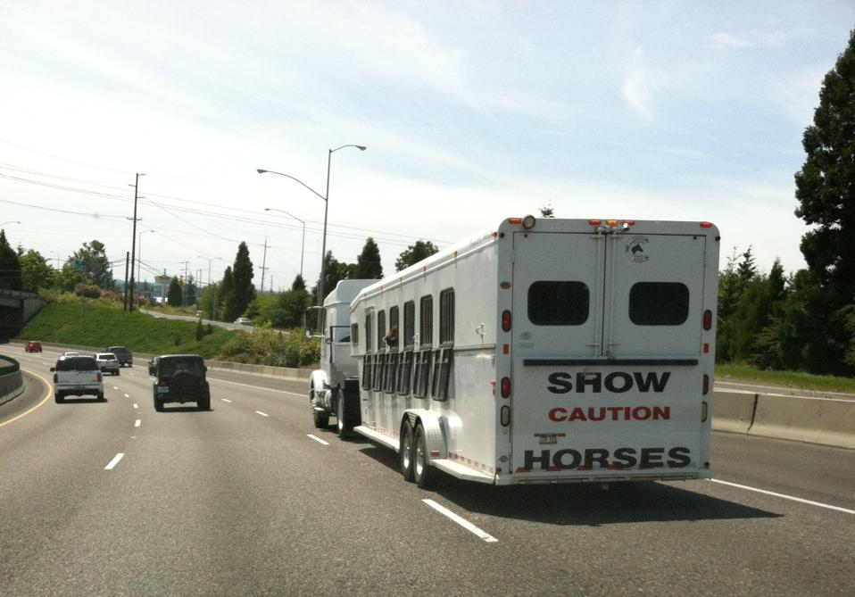
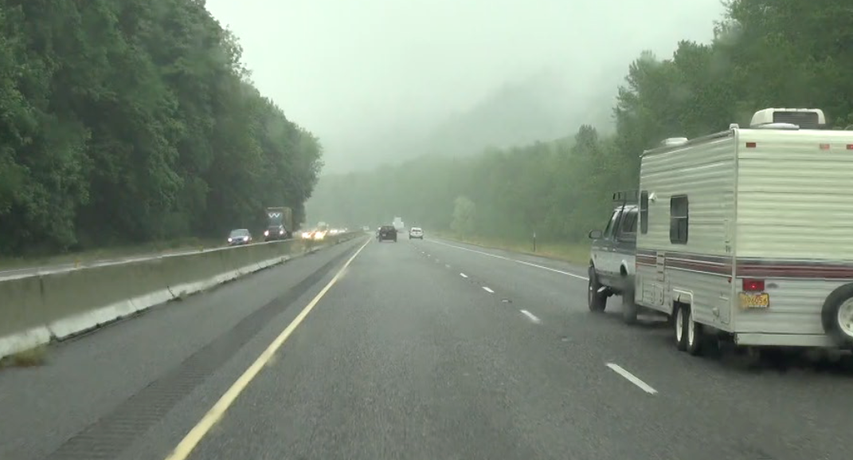
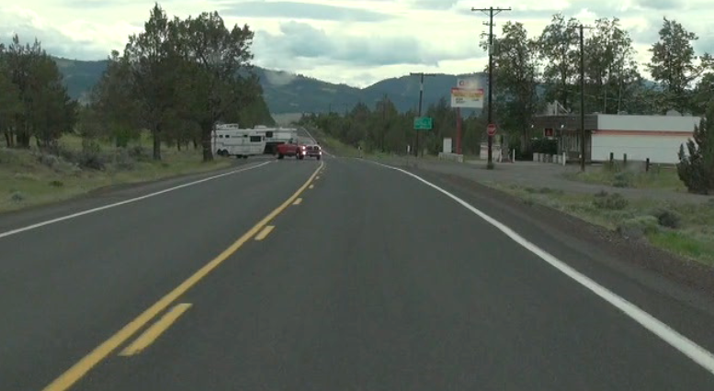
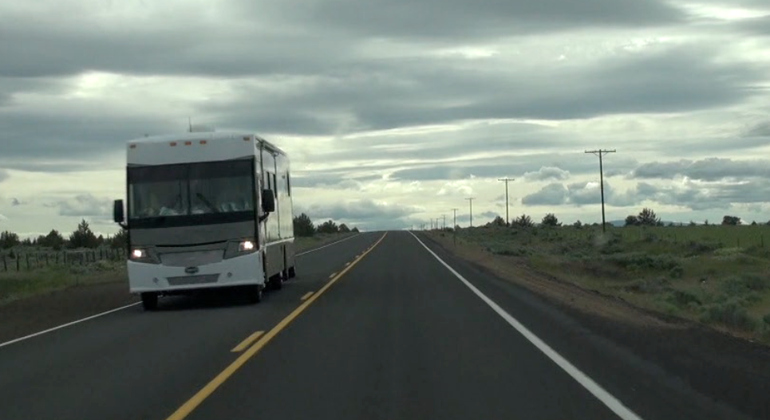

Slide 50
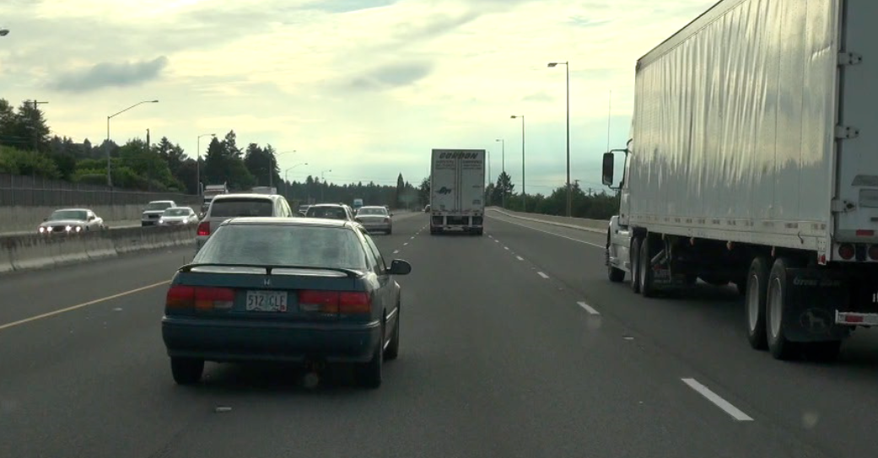
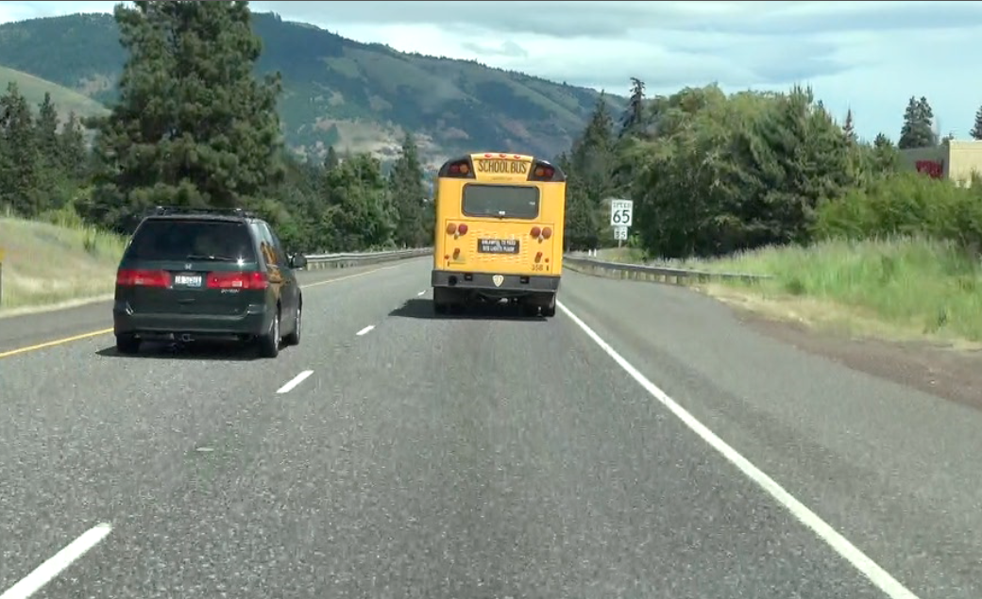
SEMI-TRUCKS AND BUSES

Slide 51
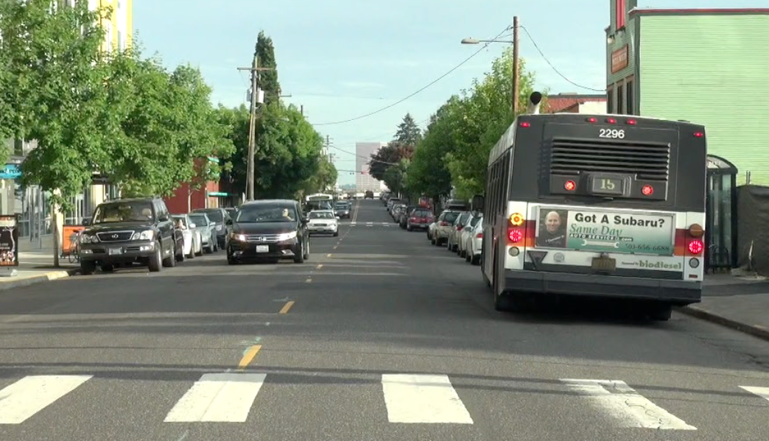
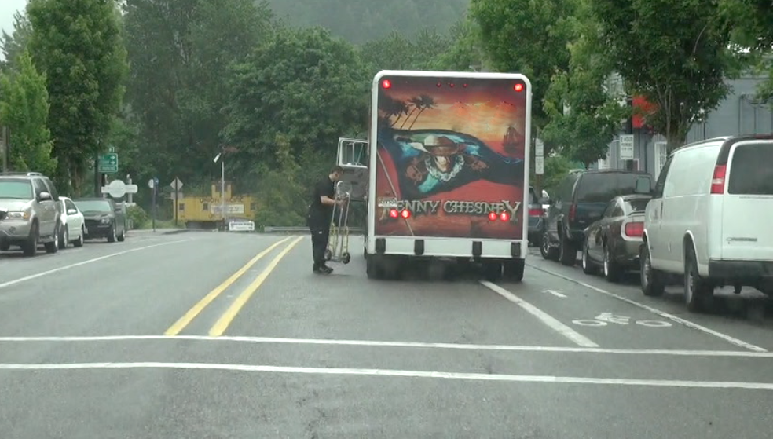
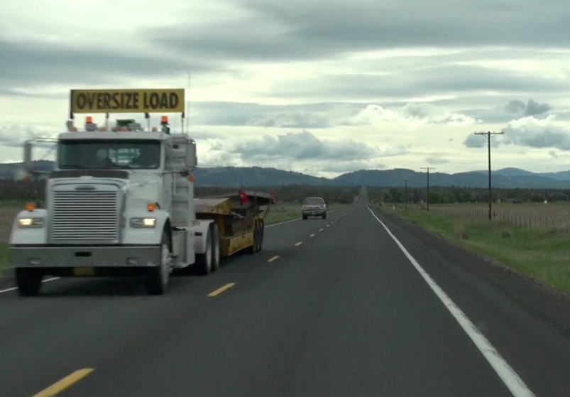
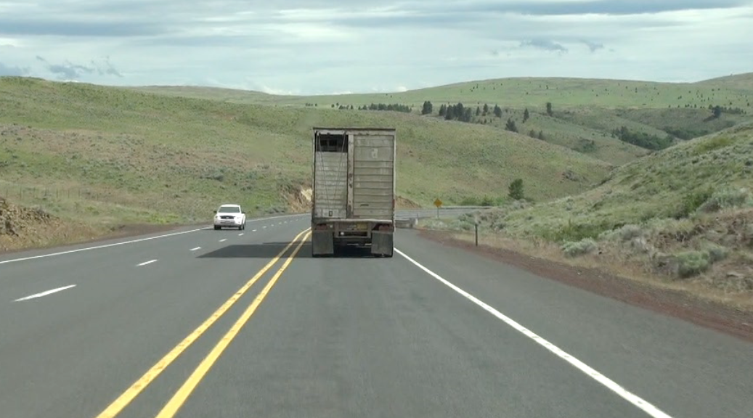

Slide 52
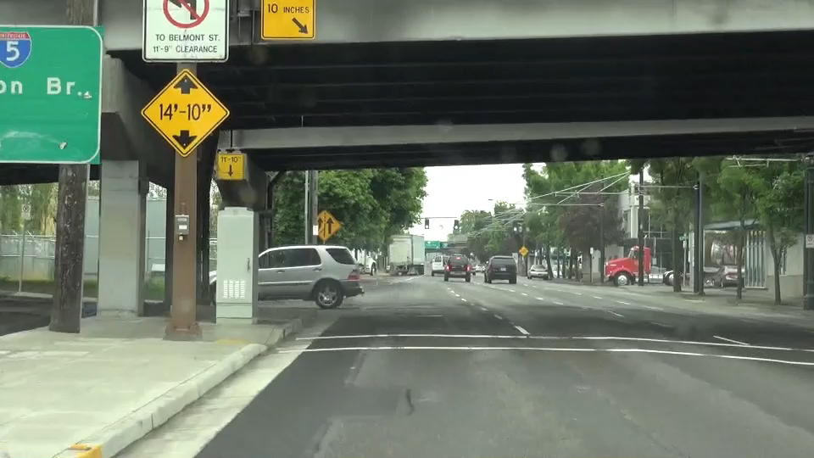
VIDEO: TURNING SEMI-TRUCK
PLAY VIDEO (:25)

Slide 53
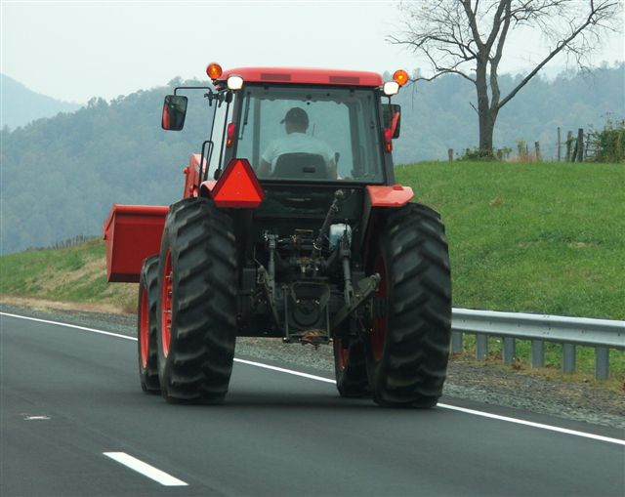
SLOW-MOVING VEHICLES, FARM EQUIPMENT AND ANIMALS

Slide 54




Slide 55
Sharing the Road
Montana Style
Find — Be aware of the situation by searching and scanning.
Solve — Know and understand your options to gain space and time.
Control — Put your options into actions to share the road.

Slide 56
Montana Driver Education and Training
Standards and Benchmarks
1. Laws and Highway System
  1.1. know the laws outlined in the Montana Driver's manual;
  1.2. understand the laws outlined in the Montana Driver's Manual; and
  1.3. consistently demonstrate knowledge and understanding by responsible adherence to highway transportation system traffic laws and control devices.
2. Responsibility
  2.1. recognize the importance of making safe and responsible decisions for owning and operating a motor vehicle;
  2.2 demonstrate the ability to make appropriate decisions while operating a motor vehicle;
  2.3. consistently display respect for other users of the highway transportation system; and
  2.4. develop positive habits and attitudes for responsible driving.
3. Visual Skills
  3.1. know proper visual skills for operating a motor vehicle;
  3.2. communicate and explain proper visual skills for operating a motor vehicle;
  3.3. demonstrate the use of proper visual skills for operating a motor vehicle; and
  3.4. develop habits and attitudes with regard to proper visual skills.
4. Vehicle Control
  4.1. demonstrate smooth, safe and efficient operation of a motor vehicle; and
  4.2. develop positive habits and attitudes relative to safe, efficient and smooth vehicle operation.
5. Communication
  5.1. consistently communicate driving intentions (i.e., use of lights, vehicle position, and personal signals);
  5.2. adjust driver behavior based on observation of the highway transportation system and other roadway users;
  5.3. adjust communication (i.e., use of lights, vehicle position, and personal signals) based on observation of the highway transportation system and other users; and
  5.4. develop positive habits and attitudes for effective communication.
6. Risk Management
  6.1. understand driver risk-management principles;
  6.2. demonstrate driver risk-management strategies; and
  6.3. develop positive habits and attitudes for effective driver risk-management.
7. Lifelong Learning
  7.1. identify and use a range of learning strategies required to acquire or retain knowledge, positive driving habits, and driving skills for lifelong learning;
  7.2. establish learning goals that are based on an understanding of one’s own current and future learning needs; and
  7.3. demonstrate knowledge and ability to make informed decisions required for positive driving habits, effective performance, and adaptation to change.
8. Driving Experience
  8.1. acquire at least the minimum number of BTW hours over at least the minimum number of days, as required by law, with a Montana-approved driver education teacher; and
  8.2. acquire additional behind-the-wheel driving experience with a parent or guardian’s assistance in a variety of driving situations (i.e., night, adverse weather, gravel road, etc.).
Notes:
Standards and Benchmarks: This is for your reference and not to be read to the class verbatim. Please review prior to the lesson so you are aware of what the student will be required to know at the end of the module.

